Slide 1
International Postage – Custom Requirements
July 2024

Slide 2
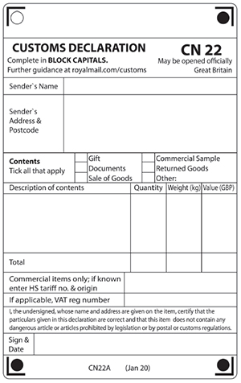
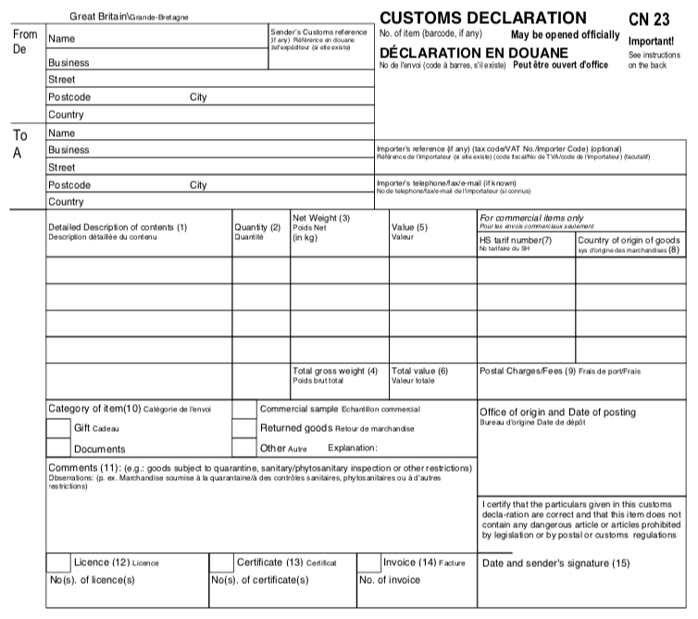
When sending goods abroad, customers must attach a customs declaration (CN22 – Value up to £270 or CN23 – Value over £270), available from Old College Post Room (508008)

Slide 3
What we need you to do for us
To help us process your mail as smoothly as possible we require the sender to attach the relevant customs label (CN22 or CN23) and input the senders name and full address (your School/Department), description of contents, quantity of contents and value of the contents.
The weight of the package will be applied by us after franking machine weighs item.
2kg is the maximum weight allowance for all packages except for printed paper (books, documents etc), which has a weight allowance of 5kg.

Slide 4
Possible VAT & Customs Charges
When sending goods abroad the recipient may then have to pay customs or VAT charges and a handling fee in the receiving country before they can claim the parcel. These charges will depend on the country they are sending to, the value of the item and whether it is a gift or commercial goods. Letters, postcards and documents are usually exempt.
When receiving goods from abroad, recipients may have to pay VAT and duties. The VAT and duties will be applied depending on the type and value of the goods. For gifts over £39 and goods over £135, Royal Mail may collect the VAT and customs duties on behalf of HM Revenue & Customs (HMRC) from the recipient prior to delivery. Letters, postcards and documents are usually exempt.

Slide 5
Standard Delivery (Not Trackable)
International standard delivery is a non trackable service where delivery is estimated at 3-5 business days to Europe and rest of the world in 6-7 business days.
This service is cheaper than Tracked & Signed for services, so for parcels going outside the UK the cost difference of your package being fully trackable from despatch to delivery would be more expensive. The plus point being that using Tracked & Signed for services enables you to give the recipient tracking details as well.
For large bulk quantities standard delivery will be more cost effective to your Department.

Slide 6
International Track & Signed Services
All international track and signed mail continue as before and if you require any information about these methods of postage don’t hesitate to contact the Post Room where we will provide all information required. Maximum weight of 2kg still applies and maximum size dimensions are length plus depth plus width no greater than 900mm, with the longest side no greater than 600mm.
International Tracked & Signed
Provides tracking overseas and takes a signature on delivery.
Online confirmation of delivery available.
International Signed
Tracked in the UK, with a signature on delivery.

Slide 7
DHL
DHL is the main courier we use outside Royal Mail
Extensive worldwide coverage: Delivery to over 220 countries and territories worldwide
Fast and reliable delivery services
Competitive pricing on both domestic and international mail/packages. DHL rates vary on location but is sometimes cheaper than using Royal Mail
Superior tracking from pick up to point of delivery
DHL require contact details (phone number and email) for the recipient.

